Slide 1
Input and Output devices:
Unit 4

Slide 2
INTRODUCTION
A computer interacts with the external environment via the input-output (I/O) devices attached to it. Input device is used for providing data and instructions to the computer. After processing the input data, computer provides output to the user via the output device. The I/O devices that are attached, externally, to the computer machine are also called peripheral devices.

Slide 3
INPUT-OUTPUT UNIT
An I/O unit is a component of computer. The I/O unit is composed of two parts—input unit and output unit. The input unit is responsible for providing input to the computer and the output unit is for receiving output from the computer.

Slide 4
Input Unit
The input unit gets the data and programs from various input devices and makes them available for processing to other units of the computer.
The input data is provided through input devices, such as—keyboard, mouse, trackball and joystick. Input data can also be provided by scanning images, voice recording, video recording, etc.
Irrespective of the kind of input data provided to a computer, all input devices must translate the input data into a form that is understandable by the computer, i.e., in machine readable form. The transformation of the input data to machine readable form is done by the input interface of input device.

Slide 5
Output Unit
The output unit gets the processed data from the computer and sends it to output devices to make them available to the user of computer.
The output data is provided through output devices like display screen, printer, plotter and speaker.
The processed data sent to the output device is in a machine understandable form. This processed data is converted to human readable form by the output interface of output device.

Slide 6
Input devices are classified as follows—
Human data entry devices
Keyboard
Pointing devices—mouse, trackball, joystick digitizing tablet
Pick devices—light pen, touch screen
Source data entry devices
Audio input—speech recognition
Video input—digital camera
Scanner—hand-held scanner, flat-bed scanner
Optical Scanner—OCR, OMR, MICR, barcode reader

Slide 7
HUMAN DATA ENTRY DEVICES
Input devices that require data to be entered manually to the computer are identified as human data entry devices. The data may be entered by typing or keying in, or by pointing a device to a particular location.

Slide 8
Keyboard
Keyboard is a common input device. It is used for entering the text data. For inputting the data, the user types the data using the keyboard. When the data is being typed, the display monitor displays the typed data.
Cursor is a vertical line, blinking line, etc. Cursor moves with each typed character. The position of cursor indicates the location on monitor where the typed-in character will be displayed.

Slide 9
The design of a keyboard is similar to a standard typewriter. The modern keyboards are QWERTY keyboard (Q, W, E, R, T, Y are the sequence of keys in top row of letters).
Standard keyboard contains 101 keys which are arranged in the same order as a typewriter. The keyboard has five sections (1) Typing keys (1, 2, 3…, A, B, C…), (2) Numeric keypad (numeric keys on right side), (3) Function keys (F1, F2…. on top side), (4) Control keys (cursor keys, ctrl, alt.…), and (5) Special-purpose keys (Enter, shift, spacebar…).

Slide 10
When a key is pressed, keyboard interacts with a keyboard controller and keyboard buffer. The keyboard controller stores the code of pressed key in keyboard buffer and informs the computer software that an action has happened on the keyboard.
The computer software checks and reads the keyboard buffer and passes the code of pressed character to the system software. Due to a time gap between pressing of a key on keyboard and reading by the system software, keyboard buffer is designed to store many keystrokes together.

Slide 11
Pointing Devices
Pointing devices are used for providing the input to computer by moving the device to point to a location on computer monitor. The input data is not typed; instead, the data is entered by moving the pointing device. The cursor on the computer monitor moves with the moving pointing device.
Operations like move, click and drag can be performed using the pointing devices. Mouse, trackball, joystick and digitizing tablet are some of the common pointing devices.

Slide 12
Mouse
It is the most common pointing input device. The mouse may also be used to position the cursor on screen, move an object by dragging, or select an object by clicking. The key benefit of using a mouse is that the cursor moves with the mouse. So, the cursor can be positioned at any location on the screen by simply moving the mouse.
Moreover, it provides an easy way to select and choose commands from menus, dialog boxes, icons, etc. Mouse is used extensively, while working with graphics elements such as line, curve, shapes, etc.

Slide 13
Mouse is a small hand-held device having two or three buttons on its upper side. In addition to the buttons, mouse also has a small wheel between the buttons. The wheel of the mouse is used for the up and down movement, for example, scrolling a long document. A mouse is classified as physical mouse or optical mouse.
Physical Mouse has a rubber ball on the bottom side that protrudes when the mouse is moved. It requires a smooth, dust free surface, such as a mouse pad, on which it is rolled.
Optical Mouse uses a Light Emitting Diode (LED) and a sensor to detect the movement of mouse. Optical mouse is better than physical mouse as there is no moving part that can cause wear and tear, and dirt cannot get inside it.

Slide 14
The mouse can be used in five different ways, as follows—
Pointing
Left Click or Click
Right Click
Double Click
Drag and Drop

Slide 15
TrackBall
Trackball is a device that is a variant of the mouse but has the functionality of mouse.
It is easy to use and takes less space than a mouse. Trackball is generally built in laptops since there is no space for the mouse to move on the lap.
Instead of moving the whole device to move the cursor on computer screen, trackball requires the ball to be rotated manually with a finger. The trackball device remains stationary. The cursor on the computer screen moves in the direction in which the ball is moved. The buttons on trackball are used in the same way as mouse buttons.

Slide 16
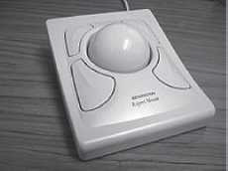
Figure : Trackball

Slide 17
Joystick
Joystick is a device which is commonly used for playing video games.
Joystick is mainly used to control the speed of the cursor and is thus popular in games involving speed like racing and flying games.

Slide 18
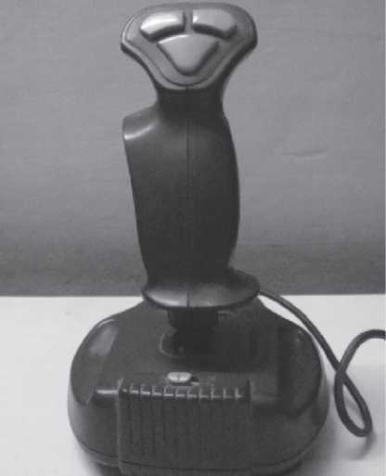
Figure: Joystick

Slide 19
Digitizing Tablet
It is an input device used primarily to input drawings, sketches, etc. Digitizing tablet is used for Computer Aided Design (CAD) for the design of buildings, automotive designs, and designing of maps, etc.
Description Digitizing tablet consists of two parts—electronic tablet and pen. The electronic tablet is a flat bed tablet. The pen looks like a ball pen but has an electronic head. The pen in moved on the tablet. Each position on the tablet corresponds to a fixed position on the screen.
Drawings can be made on the tablet using a pen, and is provided as input to computer,

Slide 20
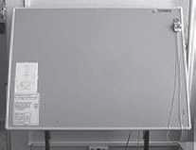
Figure: Digitizing tablet

Slide 21
Pick Devices
Pick devices are used for providing input to the computer by pointing to a location on the computer monitor. The input data is not typed; the data is entered by pointing the pick device directly on the computer screen. Light pen and touch screen are some common pick devices.

Slide 22
Light Pen
It is a light sensitive pen-like input device and is used to select objects directly on the computer screen. It is used for making drawing, graphics and for menu selection. Figures and drawings can be made by moving the pen on computer screen.

Slide 23
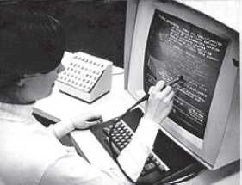
Fig: Light pen

Slide 24
Touch Screen
It is an input device that accepts input when the user places a fingertip on the computer screen. The computer selects the option from the menu of screen to which the finger points.
Touch screen are generally used in applications like Automated Teller Machine (ATM), public information computers like hospitals, airline reservation, railway reservation, supermarkets, etc.
Touch screen consists of a clear glass panel that is placed over the view area of computer screen. In addition to the glass panel with sensors, it has a device driver, and a controller that translates the information captured by the glass panel sensors to a form that the computer can understand.

Slide 25
SOURCE DATA ENTRY DEVICES
Source data entry devices are used for audio input, video input and to enter the source document directly to the computer. Source data entry devices do not require data to be typed-in, keyed-in or pointed to a particular location.

Slide 26
Audio Input Device
Audio input can be provided to the computer using human voice or speech. Audio input to the computer can be used for different purposes. It can be used for making telephone calls, for audio and video conferencing over Internet, to record voice, to create audio files and embed these files to be sent over e-mail, or, to translate spoken words into text, etc.
Audio input devices like a microphone is used to input a person’s voice into the computer. A sound card translates analog audio signals from microphone into digital codes that the computer can store and process. Sound card also translates back the digital sound into analog signals that can be sent to the speakers. Translating spoken words into text is also known as speech recognition or voice recognition.

Slide 27
Video Input Device
Video input is provided to the computer using video camera and digital camera .
Video camera can capture full motion video images. Webcam is a common video camera device. It is placed on the computer above the screen to capture the images of the user who is working on the computer.
Digital camera works like video camera but can capture still images. The information from the digital camera can be brought into the computer and stored.

Slide 28
Optical Input Devices
Optical input devices allow computers to use light as a source of input. Scanner is an example of optical input device. Other common optical input devices are Magnetic Ink Character Recognition (MICR), Optical Mark Recognition (OMR), Optical Character Recognition (OCR) and Barcode Reader.

Slide 29
Scanner
Scanner is an input device that accepts paper document as an input.
The input data to be scanned can be a picture, text etc . It uses light to convert an image into an electronic form that can be stored on the computer. Scanner accepts the source paper document, scans the document and translates it into an image to be stored on the computer.
Hand-held scanner and flat-bed scanner are the two common types of scanners.

Slide 30
Hand-held Scanner
Hand-held Scanners are portable and are placed over the document to be scanned. The scanned documents are converted and stored as an image in the computer memory. Hand-held scanners have to be moved at a constant speed over the document to be scanned. Some of the documents that are primarily scanned using hand-held scanners are price tags, ISBN number on books.

Slide 31
Flat-bed
Flat-bed Scanners provide high quality scan in a single pass. It is a box shaped machine similar to a photocopy machine and has a glass top and a lid that covers the glass. The document to be scanned is placed on the glass top, and starts the scan from left to right. They are largely used to scan full page documents.

Slide 32
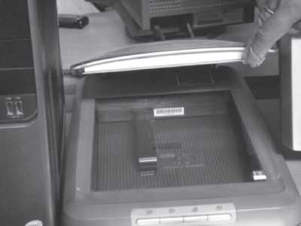
Figure : Flat bed scanner

Slide 33
OCR(Optical Character Recognition)
OCR is a technique for the scanning of a printed page, translating it, and then using the OCR software to recognize the image as ASCII text that is editable. The scanned image is converted as bitmap image which is a grid of dots. The OCR software translates dots into text that the computer can interpret as words and letters.

Slide 34
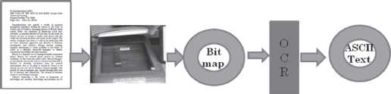
Figure: OCR system

Slide 35
Magnetic Ink Character Recognition (MICR)
MICR is used in banks to process large volumes of cheques . It is used for recognizing the magnetic encoding numbers printed at the bottom of a cheque. The numbers on the cheque are human readable, and are printed using an ink. These numbers are magnetized. MICR uses magnetic ink character reader for character recognition.
The numbers in the bottom of the cheque include the bank number, branch number and cheque number.

Slide 36
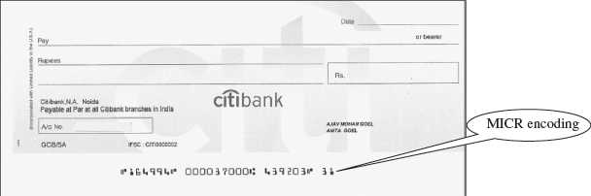
Figure: MICR encoded cheque

Slide 37
Optical Mark Recognition (OMR)
OMR is used to detect marks on a paper. The marks are recognized by their darkness. OMR uses an optical mark reader to read the marks. The OMR reader scans the forms, detects the mark that is positioned correctly on the paper and is darker than the surrounding paper, and passes this information to the computer for processing by application software. The pattern of marks is interpreted and stored in the computer.
OMR is widely used to read answers of objective type tests, where the student marks an answer by darkening a particular circle using a pencil. OMR is also used to read forms, questionnaires, order forms, etc.

Slide 38
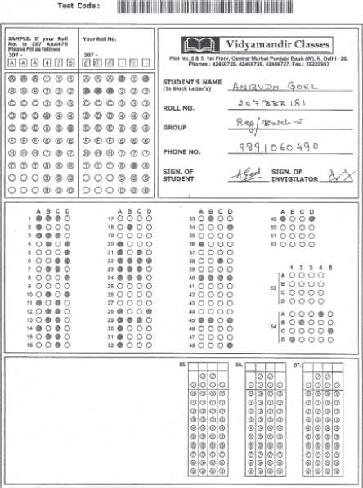
Figure: OMR answer sheet

Slide 39
Barcode Reader
Barcodes are adjacent vertical lines of different width that are machine readable. Goods available at supermarkets, books, etc. use barcode for identification. Barcodes are read using reflective light by barcode readers. Barcode readers are generally used in departmental stores to read the labels, and in libraries to read labels on books. Barcode readers are fast and accurate. They enable faster service to the customer and are also used to determine the items being sold, number of each item sold or to retrieve the price of item.

Slide 40
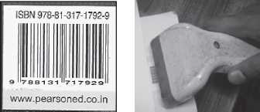
Figure : (i) Barcode of a book, (ii) Barcode reader

Slide 41
OUTPUT DEVICES
Output devices provide output to the user, which is generated after processing the input data. The processed data, presented to the user via the output devices could be text, graphics, audio or video. The output could be on a paper in a tangible form, or, in an intangible form as audio, video . Output devices are classified as follows—
Hard Copy Devices
Printer
Plotter
Soft Copy Devices
Monitor
Visual Display Terminal
Video Output
Audio Response

Slide 42
Hard Copy Devices
The output obtained in a tangible form on a paper is called hard copy output. The hard copy output can be read or used without a computer. The devices that generate hard copy output are called hard copy devices.
Printer, plotter are common hard copy output devices.

Slide 43
Printer
A printer prints the output information from the computer onto a paper. Printers are generally used to print textual information, but nowadays printers also print graphical information.
The print quality of the printer is determined by the resolution of the printer. Resolution is measured in dots per inch (dpi). Printers with a high resolution (more dpi) provide better quality output. Different kinds of printers are available for different types of applications.
Printers are classified into two categories—impact printer and non-impact printer.

Slide 44
Impact printer
Impact printers physically strikes a typeface against the paper and inked ribbon. Impact printers can print a character or an entire line at a time. Impact printers are low-cost printers.
Dot matrix printers, daisy wheel printers and drum printers are examples of impact printers.

Slide 45
Dot Matrix Printer
Dot Matrix Printers print one character at a time. The speed of dot matrix printer lies between 200 and 600 characters per second (cps). Dot matrix printers can print alphanumeric characters, special characters, charts and graphs.
They can print only in black and white. Dot matrix printers are commonly used for printing in applications like payroll and accounting.

Slide 46
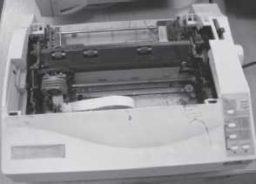
Figure: Dot matrix printer

Slide 47
Daisy Wheel Printer
Daisy Wheel Printers print one character at a time. They produce better quality than a dot matrix printer. The speed of daisy wheel printers is about 100 cps. The print head of the printer is like a daisy flower, hence the name. These printers are slow, can only print text (not graphics), and are costly in comparison to dot matrix printers.

Slide 48
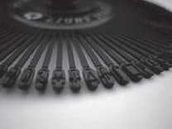
Figure : Daisy wheel for printers

Slide 49
Drum Printer
Drum Printers are line printers. They are expensive and faster than character printers but produce a low quality output. They can print 200–2500 lines per minute. Drum printers are generally used for voluminous print outputs.

Slide 50
Non-Impact Printer
Non-Impact Printers do not hit a ribbon to print. They use electro-static chemicals and ink-jet technologies. Non-impact printers are faster and quieter than impact printers.
They produce high quality output and can be used for printing text and graphics both in black and white, and color. Ink-jet printers and laser printers are non-impact printers.

Slide 51
Ink-jet Printer
Ink-jet Printers spray ink drops directly on the paper. Their resolution is more than 500 dpi. They produce high quality graphics and text. Ink-jet printers are commonly found in homes and offices.

Slide 52
Laser Printer
Laser Printers provide highest quality of text and graphics printing.
Laser printers process and store the entire page before printing and are also known as page printers. The laser printer can print 5–24 pages of text per minute and their resolution ranges from 400 to 1200 dpi. They are faster and expensive than impact printers. Laser printers are used in applications requiring high quality voluminous printing.

Slide 53
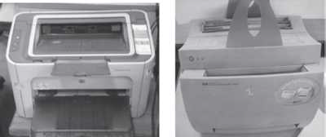
Figure : (i) Inkjet printer, (ii) Laser printer

Slide 54
Plotter
A plotter is used to draw graphs, maps, blueprints of ships, buildings, etc. Plotters use pens of different colors for drawing. Plotter is a slow output device and is expensive.
Plotters are mainly used for drawings in AUTOCAD (computer assisted drafting), Computer Aided Design (CAD) and Computer Aided Manufacturing (CAM) applications.

Slide 55
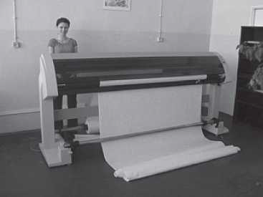
Figure: Plotter

Slide 56
Soft Copy Devices
The output obtained in an intangible form on a visual display, audio unit or video unit is called soft copy output. The soft copy output requires a computer to be read or used. The devices that generate soft copy output are called soft copy devices.
Visual output devices like computer monitor, visual display terminal, video system and audio response system are common soft copy output devices.

Slide 57
Monitor
Monitor is a common output device. A monitor is of two kinds - monochrome display monitor and color display monitor. A monochrome display monitor uses only one color to display text and color display monitor can display 256 colors at one time.
An image on the monitor is created by a configuration of dots, also known as pixels. The clarity of image on the computer screen depends on Resolution of Screen.
Monitors may be Cathode Ray Tube (CRT) monitors that look like a television, Liquid Crystal Display (LCD) monitor or LED(Light Emitting Display).

Slide 58
Visual Display Terminal
A monitor and keyboard together are known as Visual Display Terminal (VDT). A keyboard is used to input data and monitor is used to display the output from the computer.
Terminals are categorized as dumb, smart and intelligent terminals. The dumb terminals do not have processing and programming capabilities. Smart terminals have built-in processing capability but do not have its own storage capacity. Intelligent terminals have both built-in processing and storage capacity.

Slide 59
Video Output
Screen image projector or data projector is an output device that displays information from the computer onto a large white screen. The projector is mainly used to display visual output to a large gathering of people required for the purposes of teaching, training, meetings, conference presentations, etc.

Slide 60
Audio Response
Audio response provides audio output from the computer. Audio output device like speakers, headphone is used for audio output sound from computer.
The signals are sent to the speakers via the sound card that translates the digital sound back into analog signals. Audio output is commonly used for customer service in airlines, banks, etc. It is also used in video conferences, surveys, etc.

Slide 61
I/O PORT
The I/O ports are the external interfaces that are used to connect input and output devices like printer, modem and joystick to the computer. The I/O devices are connected to the computer via the serial and parallel ports, Universal Serial Bus (USB) port, Firewire port, etc.

Slide 62
Parallel Port: A parallel port is an interface for connecting eight or more data wires. The data flows through the eight wires simultaneously. They can transmit eight bits of data in parallel. As a result, parallel ports provide high speed data transmission. Parallel port is used to connect printer to the computer.
Serial Port: A serial port transmits one bit of data through a single wire. Since data is transmitted serially as single bits, serial ports provide slow speed data transmission. Serial port is used to connect external modems, plotters, barcode reader , etc.
USB Port: Nowadays, USB is a common and popular external port available with computers. Normally, two to four USB ports are provided on a PC. USB allows different devices to be connected to the computer . USB also has the plug and play feature which allows devices ready to be run simply by plugging them to the USB port. A single USB port can support connection of up to 127 devices.
In addition to the above ports, other ports also exist like Musical Instrument Digital Interface (MIDI) port to connect musical instruments like synthesizers and drum machines, PC expansion Boards etc

Slide 63
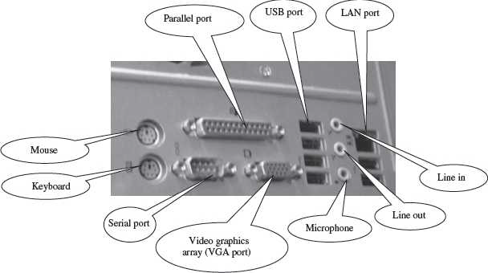
Figure : Backside of computer cabinet with different ports

Slide 64
WORKING OF I/O SYSTEM
The working of I/O system combines I/O hardware and I/O software. The I/O hardware includes ports, buses and device controllers for different devices, and I/O devices. The I/O software is the device driver software that may be embedded with operating system or comes with each device.
The working of I/O system is described as follows—

Slide 65
Device Controller operates on a bus, a port or a device. It controls the signals on the wires of port or bus. The controllers have one or more registers for data and control signals. Some devices have their own built-in controllers.
Device Driver is software via which the operating system communicates with the device controllers. Each device has its own device driver, and a device controller which is specific to the device. The device drivers hide the differences among the different device controller and present a uniform interface to the operating system.
Application programs use an I/O device by issuing commands and exchanging data with the device driver. The device driver provides correct commands to the controller, interprets the controller register, and transfers data to and from device controller registers as required for the correct device operation.
Operating system ------ Device Drivers -------- Device Controllers -------- Devices

Slide 66
******* THE END ********

